Slide 1
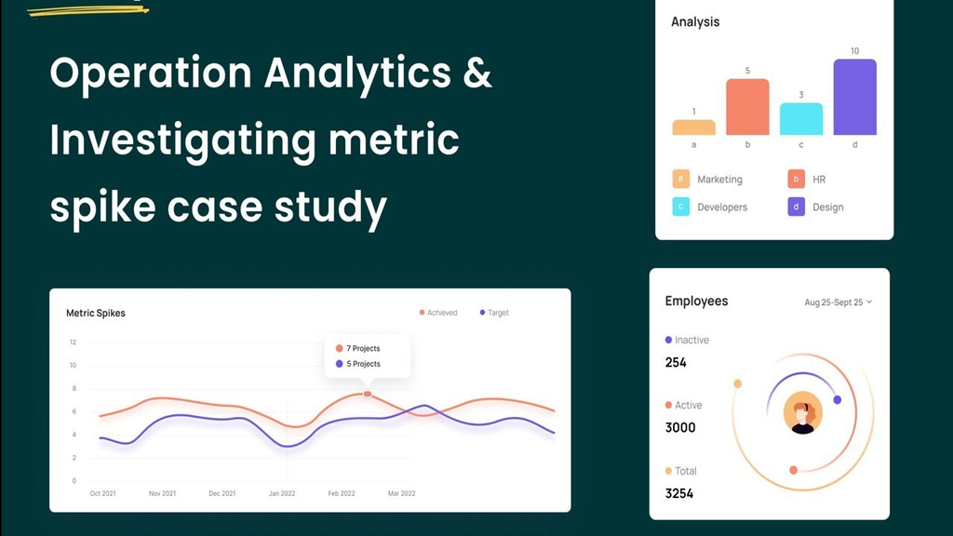

Operation and Metric Analytics
SQL Project - Data Analytics

Slide 2
As a Lead Data Analyst at a company like Microsoft, your role involves using advanced SQL skills to analyze operational data and provide insights that help various teams, such as operations, support, and marketing, improve efficiency. A key focus will be investigating and explaining sudden changes in key metrics, like drops in user engagement or sales, to enhance the company's overall performance.
Problem Description:

Slide 3
  Firstly, I spent some time on understanding the data/table given.
  I cleared the questions which was in my mind like what does the job_id, actor_id, event means and what are the things to consider while reviewing the data.
  I use SQL to derive different insights from the dataset provided by the management team.
  I first created a database “operation_analytics” and then the tables using the structure and links provided by the team.
  Then, we performed analysis to generate valuable insights for the company.
Project Approach:

Slide 4
The tech stack used include of MySQL Workbench which is an excellent tool for querying the database.
Tech Task Used:

Slide 5

1) Case Study 1: Job Data Analysis
A) Jobs Reviewed Over Time:
  Objective: Calculate the number of jobs reviewed per hour for each day in November 2020.
  Your Task: Write an SQL query to calculate the number of jobs reviewed per hour for each day in November 2020.
SQL Query:
select avg(t) as "avg jobs reviewed per day per hour",
avg(p) as "avg jobs reviewed per day per second"
from ( select ds,
((count(job_id) * 3600) / sum(time_spent)) as t,
(count(job_id) / sum(time_spent)) as p
from job_data
where month(ds) = 11
group by ds
) a;
SQL Task:
Query Result:

Slide 6
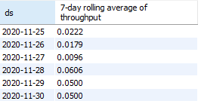
B) Throughput Analysis:
  Objective: Calculate the 7-day rolling average of throughput (number of events per second).
  Your Task: Write an SQL query to calculate the 7-day rolling average of throughput. Additionally, explain whether you prefer using the daily metric or the 7-day rolling average for throughput, and why.
SQL Query:
SQL Task:
select ds,
count(event)/sum(time_spent) as "7-day rolling average of throughput"
from job_data
group by ds
order by ds;
Query Result:

Slide 7
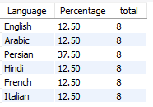
C) Language Share Analysis:
  Objective: Calculate the percentage share of each language in the last 30 days.
  Your Task: Write an SQL query to calculate the percentage share of each language over the last 30 days.
SQL Query:
select language as Language,
round(100 * count(*) / total , 2) as Percentage, sub.total
from job_data
cross join (
select count(*) as Total
from job_data ) as sub
group by language, sub.total;
SQL Task:
Query Result:

Slide 8

D) Duplicate Rows Detection:
  Objective: Identify duplicate rows in the data.
  Your Task: Write an SQL query to display duplicate rows from the job_data table.
SQL Query:
SQL Task:
select actor_id,
count(*) as duplicate
from job_data
group by actor_id
having count(*) > 1 ;
Query Result:

Slide 9
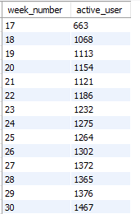
2) Case Study 2: Investigating Metric Spike
A) Weekly User Engagement:
  Objective: Measure the activeness of users on a weekly basis.
  Your Task: Write an SQL query to calculate the weekly user engagement.
SQL Query:
select extract(week from occurred_at) as week_number,
count(distinct user_id) as active_user
from events
where event_type = 'engagement'
group by week_number
order by week_number ;
SQL Task:
Query Result:

Slide 10
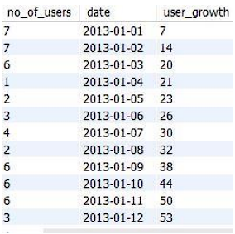
B) User Growth Analysis:
  Objective: Analyze the growth of users over time for a product.
  Your Task: Write an SQL query to calculate the user growth for the product.
SQL Query:
set @g := 0;
select a.no_of_users,
a.date,
( @g := @g + a.no_of_users ) as user_growth
from (
select count(user_id) as no_of_users,
date(created_at) as date
from users
where state = "active"
group by date(created_at) ) a;
SQL Task:
Query Result:

Slide 11
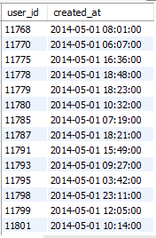
C) Weekly Retention Analysis:
Objective: Analyze the retention of users on a weekly basis after signing up for a product.
Your Task: Write an SQL query to calculate the weekly retention of users based on their sign-up cohort.
SQL Query:
select user_id,
created_at
from users
where created_at > '2014-05-01'
order by user_id;
SQL Task:
Query Result:

Slide 12
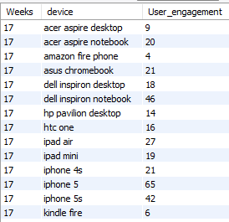
D) Weekly Engagement Per Device:
Objective: Measure the activeness of users on a weekly basis per device.
Your Task: Write an SQL query to calculate the weekly engagement per device.
SQL Query:
select week(occurred_at) as Weeks,
device, count(distinct user_id)as User_engagement
from events
group by device,
week(occurred_at)
order by week(occurred_at);
SQL Task:
Query Result:

Slide 13
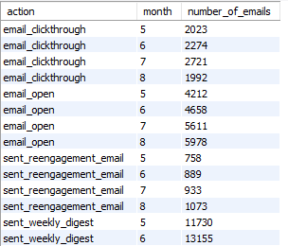
E) Email Engagement Analysis:
Objective: Analyze how users are engaging with the email service.
Your Task: Write an SQL query to calculate the email engagement metrics.
SQL Query:
select action,
extract(month from occurred_at) as month,
count(action) as number_of_emails
from email_events
group by action, month
order by action, month;
SQL Task:
Query Result:

Slide 14
Case Study 1 (Job Data):
• The number of distinct jobs reviewed per hour per day for November 2020 is 83%.
• We used the 7-day rolling average of throughput as it gives the average for all the days right from day 1 to day 7 whereas, daily metric gives the average for only that particular day itself.
• The percentage share of Persian language is the most (37.5%).
• There are two duplicate rows if we partition the data by job_id. But if we look the overall columns, all the rows are unique.
Insights:

Slide 15
Case Study 2 (Investigating metric spike):
• The weekly user engagement increased from week 18th to week 31st and then started declining from then onwards. This means that some of the users do not find much quality in the product/service in the last of the weeks.
• There are in total 9381 active users from 1st week of 2013 to the 35th week of 2014.
• The overall count of weekly engagement per device used is the most for MacBook users and iPhone users.
• The email opening rate is around 34% and email clicking rate is around 15%. The users are engaging with the email service which is good for the company to expand.
Insights:

Slide 16
In this project, I learned how to apply advanced SQL concepts like Windows Functions, etc. I understood how the real-world industry works. It helped me in mastering my SQL concepts. I learned how to ask the right questions given the circumstances. From the given data and questions, which columns to consider and how to find the valuable insights which help the business to grow. I learned how the company find different areas related to the company to improve it further. I got to know about investigating metric spike (why there is a boom and why there is a dip).
Result:

